Slide 1

React with Redux

Slide 2
Traditional Websites
BROWSER
SERVER
HTTP + URL
NAVIGATION
HTML PAGES
CSS
HTML + CSS
HTTP + URL
HTML + CSS
Page
Reload!
Notes:
This cycle initiates by requesting index.html to server-side from client-side.
The server looks for the requested page and serves it back to the client. (This is one complete cycle of HTTP response and request lifecycle.)
If the client wants to access the new page or submits the form, which its first request was a form, it has to make a new request to the server causing the page to be reloaded.

Slide 3
Traditional Web Apps
BROWSER
SERVER
HTTP + URL
NAVIGATION
HTML + CSS
Server PAGES
CSS
HTTP + URL
ASP
ASP .NET
JSP
PHP
Ruby
Express JS
Database
HTML + CSS
Page
Reload!

Slide 4
Traditional Web Apps – Partial Rendering
BROWSER
HTTP + URL
SERVER
NAVIGATION
Server PAGES
CSS
HTML + CSS + JS
AJAX - HTTP + URL
JS
PARTIAL HTML
<table>
<thead>
<tr>
<th>ID</th>
</tr>
</thead>
<tbody>
<tr>
<td>1</td>
</tr>
</tbody>
</table>
Partial
Page
Reload!
ASP .NET
JSP
Ruby
PHP
Express JS
ASP .NET MVC
Spring MVC
Ruby On Rails
Laravel
Sails JS
Database

Slide 5
Single Page Applications
BROWSER
SERVER
NAVIGATION
HTTP + URL
HTML Page
CSS
JS
HTML + CSS + JS
ASP .NET
JSP
Ruby
PHP
Express JS
ASP .NET MVC
Spring MVC
Ruby On Rails
Laravel
Sails JS
<table>
<thead>
<tr>
<th>ID</th>
</tr>
</thead>
<tbody>
<tr>
<td>1</td>
</tr>
</tbody>
</table>
AJAX - HTTP + URL
SERVER
Database
RESTful API
ASP .NET Web API
JWS
Express JS
JSON
{ “id” : 1 }
JSON to HTML on Client Side
Vanilla JS, jQuery, KO, BB, NG 1,
NG 2 & above, Vue JS, React JS

Slide 6
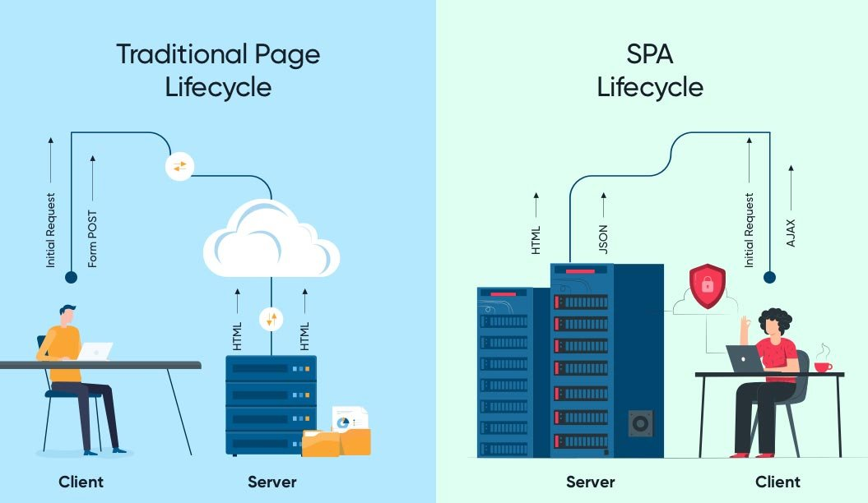

Slide 7
JavaScript Full Stack Application
 | Database | Application FW API FW | Client Side | Runtime
MEAN | MongoDB | Express JS | Angular | Node
MERN | MongoDB | Express JS | React JS | Node
MEVN | MongoDB | Express JS | Vue JS | Node

Slide 8
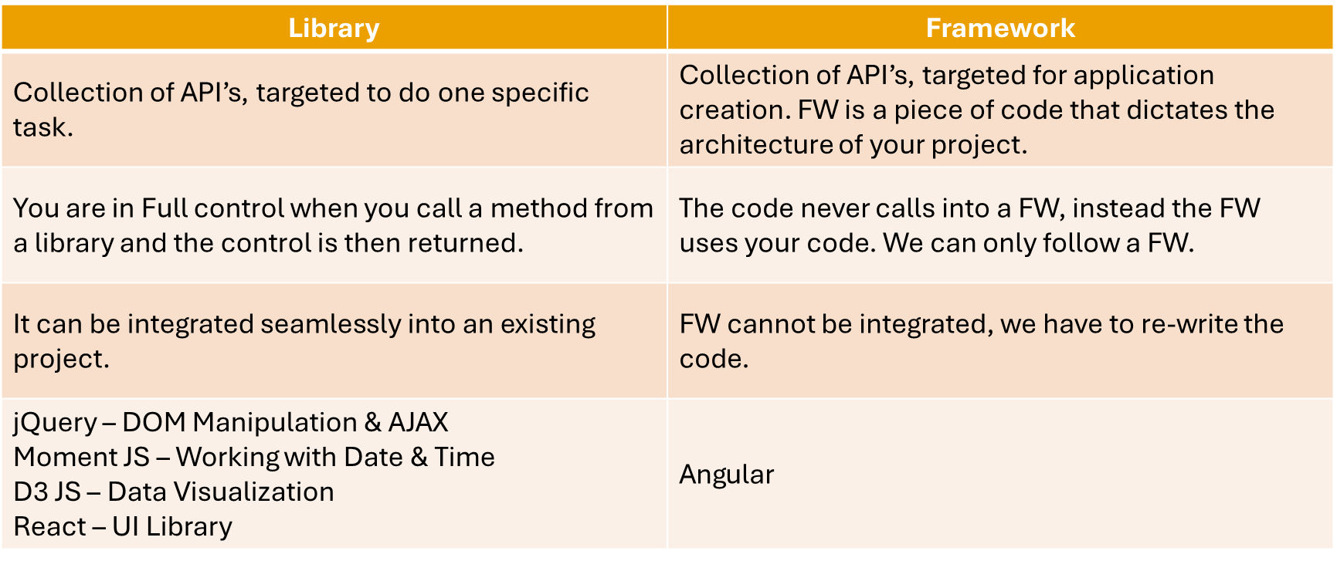
Library vs Framework

Slide 9
Single Page Application Pros
Quick Loading Time
Seamless User Experience
Ease in Building Feature-rich Apps
Uses Less Bandwidth

Slide 10
Single Page Application Cons
Doesn’t Perform Well With SEO
One of the metrics that search engines use is the number of pages a website has. However, since SPAs only load a single page, it serves as a disadvantage when ranking on search engines
Uses a Lot of Browser Resources
SPAs require many resources from the web browser since the browser is doing most of the tasks for the SPAs.
Security Issues
As compared to multi-page apps, SPAs are more prone to cross-site scripting attacks.

Slide 11
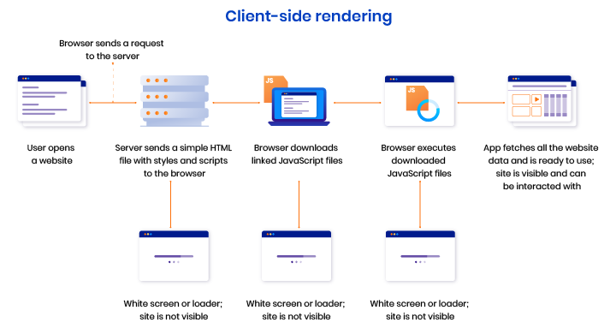

Slide 12
Server Side Rendering – Hybrid Approach
Server-side rendering (SSR) is a technique used to render a single-page application (SPA) on the server instead of in the client’s browser.
Benefits of SSR
Improved performance and user experience
SEO friendliness
Content sharing
Accurate page loading metrics

Slide 13
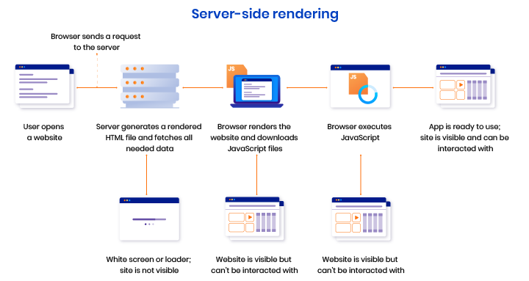

Slide 14
Installation
Install Node LTS version - https://nodejs.org/en/
Install / Update Visual Studio Code to Latest Release - https://code.visualstudio.com/
Extensions of VS Code
AutoFileName
vscode-icons
JavaScript (ES6) code snippets
CSS Formatter
IntelliSense for CSS class names in HTML
Reactjs code snippets

Slide 15
Babel
Babel is a JavaScript compiler.
Babel is a toolchain that is mainly used to convert ECMAScript 2015+ code into a backwards compatible version of JavaScript in current and older browsers or environments.
Here are the main things Babel can do for you:
Transform syntax
Polyfill features that are missing in your target environment (through a third-party polyfill such as core-js)
Source code transformations (codemods)

Slide 16
Steps to run the application
Download and Extract the zip file.
Open the extracted folder in Visual Studio Code
Open the terminal window on the folder path and run
npm install
Compile the code
npx babel src --out-dir output
Once the installation completes, run
node output/main.js

Slide 17
To Install in new Project
npm init -y
npm i -D @babel/core @babel/preset-env @babel/cli
npm i core-js
Create babel.config.json file with configuration
To Compile
npx babel --version
npx babel src --out-dir output

Slide 18
Build Tools
Build Tools are utilities that help automate the transformation and bundling of your code into a single file. Most JavaScript projects use these build tools to automate the build process.
There are several common build tools available that can be integrated with Babel.
Some of the tools are:
Browserify
Grunt
Gulp
Webpack

Slide 19
Webpack
We need a module bundler like Webpack to resolve dependencies.
Webpack can understand the relationships between multiple files and "resolve" them in a process called dependency resolution.
Dependency resolution doesn't just which files are needed but the order they are required in since any dependency can rely on another.
Webpack Dev Server:
A NodeJS server and its purpose is to propagate changes from your webpack bundle to your browser during the development of your app
Hot Module Reloading:
This feature allows the app to continue running in its current state whilst the parts you are changing can be swapped out live.

Slide 20
Webpack Configuration
Entry Point
Extensions
Loaders (Used to pre-process files)
Plugins
Optimization
Output

Slide 21
Client Side Build
ES 2015 +
(Multiple Files)
Manual Configuration
Learn Node JS
Learn Webpack
Learn Babel & Config.
Babel +
Preset (Env) +
Polyfill (core-js)
Build & Deploy your
Project on Local Server
Build your project
Browser Compatible Files
(Multiple Files)
Auto Configuration
react-cli (create-react-app)
WEBPACK-DEV-
SERVER
WEBPACK
CLI
Bundling
BROWSER
WEBPACK
Single File / Set of Files
Local
HTTP Server
HTML PAGE
Deploy
Inject Bundles

Slide 22
Steps to run the application
Download and Extract the zip file.
Open the extracted folder in Visual Studio Code
Open the terminal window on the folder path and run
npm install
Once the installation completes, run
npm start – Starts the Development Server on localhost:3000
npm run build – To create a production build in dist folder
npm run build-serve – To create a production build in dist folder and serve it locally

Slide 23
Datatypes
Primitive Types – Immutable
Primitive Values
undefined
null
Primitive Datatypes
string String()
number Number()
boolean Boolean()
symbol Symbol() – ES6 – You cannot use new keyword with Symbol()
Object Types – Mutable
object Object()

Slide 24
Mutable vs Immutable
JavaScript Engine handles mutable and immutable objects differently.
Immutable are quicker to access than mutable objects.
Mutable objects are great to use when you need to change the size of the object, example array, set etc..
Immutable are used when you need to ensure that the object you made will always stay the same.
Immutable objects are fundamentally expensive to “change”, because doing so involves creating a copy.
Changing mutable objects is cheap.

Slide 25
Statements
Control Flow
Block { }
break
continue
Empty
if…else
switch
throw
try…catch
Iterations
for
for...in
for…of
while
do…while

Slide 26
Functions
function
Declares a function with the specified parameters.
function*
Generator Functions enable writing iterators more easily.
async function
Declares an async function with the specified parameters.
return
Specifies the value to be returned by a function.

Slide 27
Function Parameters & Arguments
Function Parameters are the names that are define in the function definition and real values passed to the function in function definition are known as arguments.
Parameter Rules:
There is no need to specify the data type for parameters in JavaScript function definitions.
It does not perform type checking based on passed in JavaScript function.
It does not check the number of received arguments.
If a function is called with missing arguments (less than declared), the missing values are set to undefined.

Slide 28
The Arguments Object
JavaScript functions have a built-in object called the arguments object.
The argument object contains an array of the arguments used when the function was called (invoked).
If a function is called with too many arguments (more than declared), these arguments can be reached using the arguments object.

Slide 29
Rest & Spread
The rest operator (…) allows us to call a function with any number of arguments and then access those excess arguments as an array. The rest operator also allows us in destructuring array or objects.
The spread operator (…) allows us to expand an iterable like array into its individual elements.

Slide 30
Pure and Impure Functions
A side-effect is any operation your function performs that is not related to computing the final output, including but not limited to:
Modifying a global variable
Modifying an argument
Making HTTP requests
DOM manipulation
Reading/writing files
A pure function must both be predictable and without side-effects. If either of these criteria is not met, we're dealing with an impure function.
A pure function, returns same result if same arguments are passed in, no matter how many times it runs.
An impure function, may return different result if same arguments are passed in, on multiple runs

Slide 31
IIFE
Immediately Invoked Function Expression (IIFE) is one of the most popular design patterns in JavaScript.
It is pronounced as, iify.
As name suggest, IIFE is a function expression that automatically invokes after completion of the definition.
IEFE solves this problem by having its own scope and restricting functions and variables to become global.
The functions and variables declare inside IIFE will not pollute global scope even they have same name as global variables & functions.

Slide 32
JavaScript ‘this’ keyword
In JavaScript, “context” refers to an object.
Within an object, the keyword “this” refers to that object, and provides an interface to the properties and methods that are members of that object.
When a function is executed, the keyword “this” refers to the object that the function is executed in.
Scenarios
When a function executes in the global context, “this” refers to the global, or “window” object
When a function is a method of an Object, “this” refers to that object (unless it is manually executed in the context of a different object)
When a function executes inside of another function (no matter how deeply nested), “this” refers to the object whose context within which it is executed
When you instantiate a constructor function, inside of the instance object, “this” refers to the instance object

Slide 33
Higher Order Functions
Functions that operate on other functions, by taking them as arguments and by returning them, are called higher-order functions.
Higher-order functions allow us to abstract over actions, not just values.

Slide 34
Closure
A closure is a function or reference to a function together with a referencing environment — a table storing a reference to each of the non-local variables of that function.
Closures are functions that refer to independent (free) variables. In other words, the function defined in the closure 'remembers' the environment in which it was created.
A closure is a special kind of object that combines two things: a function, and the environment in which that function was created. The environment consists of any local variables that were in-scope at the time that the closure was created.

Slide 35
Function Currying
Currying is a way of constructing functions that allows partial application of a function’s arguments.
What this means is that you can pass all the arguments a function is expecting and get the result or pass a subset of those arguments and get a function back that’s waiting for the rest of the arguments.

Slide 36
Constructor Function
In JavaScript, a constructor function is used to create objects.
To create an object from a constructor function, we use the new keyword.
It is considered a good practice to capitalize the first letter of your constructor function.
When this keyword is used in a constructor function, this refers to the object when the object is created.

Slide 37
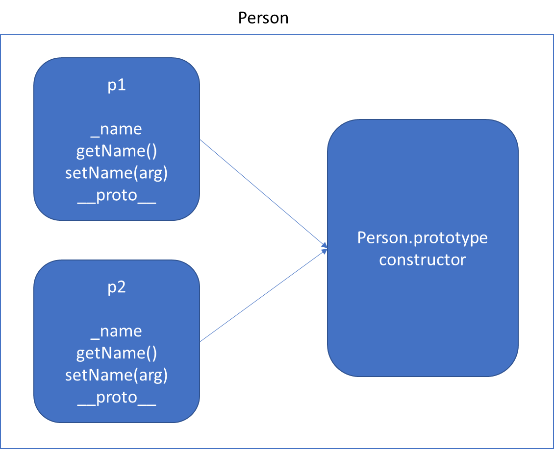
Function Using this keyword *Will increase memory Usage

Slide 38
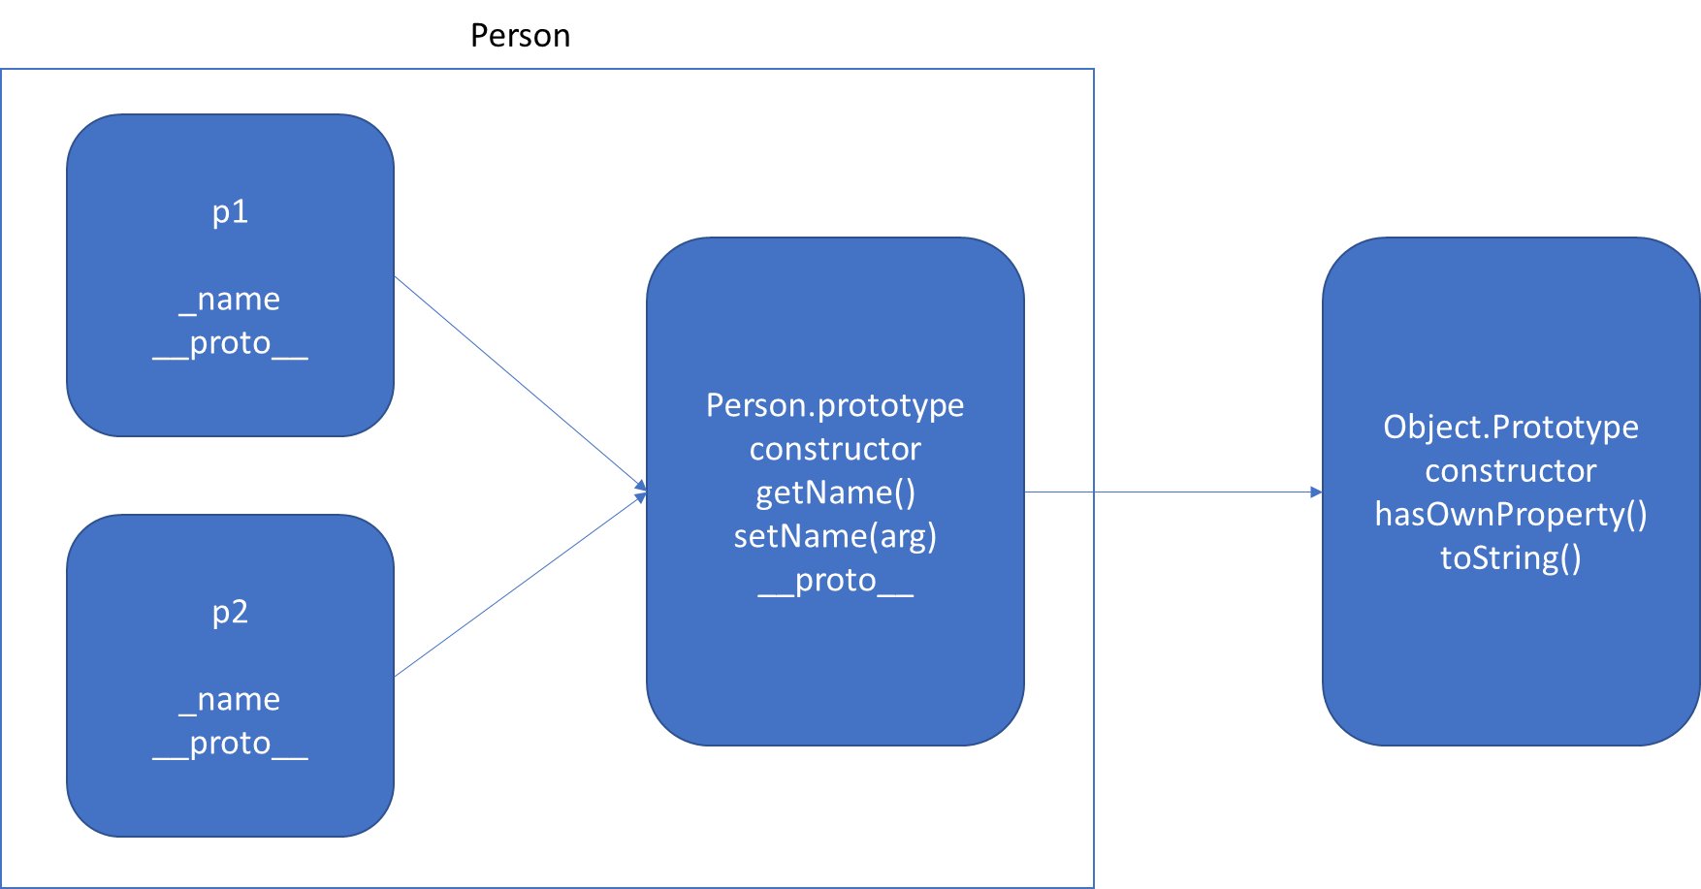
Function Using prototype

Slide 39
v.start()
Vehicle.prototype
start()
__proto__
Object.prototype
constructor
hasOwnProperty()
toString()
.
.
v
__proto__
FourWheeler.prototype
__proto__
Object.prototype
constructor
hasOwnProperty()
toString()
.
.
v.start() - Error
v
__proto__

Slide 40
Static
The static keyword defines a static method or property for a class. Neither static methods nor static properties can be called on instances of the class. Instead, they're called on the class itself.
Static methods are often utility functions, such as functions to create or clone objects.
Static properties are useful for caches, fixed-configuration, or any other data you don't need to be replicated across instances.

Slide 41
Inheritance
When it comes to inheritance, JavaScript only has one construct: objects.
Each object has a private property which holds a link to another object called its prototype. That prototype object has a prototype of its own, and so on until an object is reached with null as its prototype.
By definition, null has no prototype, and acts as the final link in this prototype chain.
It is possible to mutate any member of the prototype chain or even swap out the prototype at runtime.

Slide 42
Class Inheritance
Classes support prototype-based inheritance, super calls, instance and static methods and constructors.
We use extends to inherit from another class and the super keyword to call the parent class (function).

Slide 43
FourWheeler.prototype
move()
__proto__
Vehicle.prototype
start()
__proto__
Object.prototype
constructor
hasOwnProperty()
toString()
.
.
v
__proto__
FourWheeler.prototype
start()
move()
__proto__
Vehicle.prototype
start()
__proto__
Object.prototype
constructor
hasOwnProperty()
toString()
.
.
v
__proto__

Slide 44
Indexed collections
Array
Int8Array
Uint8Array
Uint8ClampedArray
Int16Array
Uint16Array
Int32Array
Uint32Array
Float32Array
Float64Array

Slide 45
Arrays
Arrays are an ordered collection that can hold data of any type. In JavaScript, arrays are created with square brackets [...] or using Array constructor and allow duplicate elements.
JavaScript objects and arrays were the most important data structures to handle collections of data.
The combination of objects and arrays was able to handle data in many scenarios, however, there were a few shortcomings as follows
Object keys can only be of type string.
Objects don't maintain the order of the elements inserted into them.
Objects lack some useful methods, which makes them difficult to use in some situations. For example, you can't compute the size (length) of an object easily. Also, enumerating an object is not that straightforward.
Arrays are collections of elements that allow duplicates. Supporting arrays that only have distinct elements requires extra logic and code.

Slide 46
Keyed collections
Map
Set
WeakMap
WeakSet

Slide 47
Map
Map is a collection of key-value pairs where the key can be of any type. Map remembers the original order in which the elements were added to it, which means data can be retrieved in the same order it was inserted in.
In other words, Map has characteristics of both Object and Array:
Like an object, it supports the key-value pair structure.
Like an array, it remembers the insertion order.
A new Map can be created using Map Constructor.
Use Map when:
You may want to create keys that are non-strings. Storing an object as a key is a very powerful approach. Map gives you this ability by default.
You need a data structure where elements can be ordered. Regular objects do not maintain the order of their entries.
You are looking for flexibility without relying on an external library like lodash.

Slide 48
Set
A Set is a collection of unique elements that can be of any type.
Set is also an ordered collection of elements, which means that elements will be retrieved in the same order that they were inserted in.
A Set in JavaScript behaves the same way as a mathematical set.
Use Set when
You need to maintain a distinct set of data to perform set operations like union, intersection, difference, and so on.

Slide 49
Weak Map
The WeakMap object is a collection of key/value pairs in which the keys are objects only and the values can be arbitrary values.
The object references in the keys are held weakly, meaning that they are a target of garbage collection (GC) if there is no other reference to the object anymore.
One difference to Map objects is that WeakMap keys are not enumerable.
One use case of WeakMap objects is to store private data for an object, or to hide implementation details.

Slide 50
Weak Set
WeakSet objects are collections of objects.
An object in the WeakSet may only occur once.
It is unique in the WeakSet's collection, and objects are not enumerable.
The main differences to the Set object are:
In contrast to Sets, WeakSets are collections of objects only, and not of arbitrary values of any type.
The WeakSet is weak: References to objects in the collection are held weakly. If there is no other reference to an object stored in the WeakSet, they can be garbage collected. That also means that there is no list of current objects stored in the collection.
WeakSets are not enumerable.
The use cases of WeakSet objects are limited.
They will not leak memory, so it can be safe to use DOM elements as a key and mark them for tracking purposes.

Slide 51
Well-Known symbols
A list of symbols that JavaScript treats specially is published as well-known symbols.
Well-known symbols are used by built-in JavaScript algorithms. For example Symbol.iterator (@@iterator) is utilized to iterate over items in arrays, strings, or even to define your own iterator function.

Slide 52
Well-known symbol
Specification Name | [[Description]] | Value and Purpose
@@hasInstance | "Symbol.hasInstance" | A method that determines if a constructor object recognizes an object as one of the constructor’s instances. Called by the semantics of the instanceof operator.
@@isConcatSpreadable | "Symbol.isConcatSpreadable" | A Boolean valued property that if true indicates that an object should be flattened to its array elements by Array.prototype.concat.
@@iterator | "Symbol.iterator" | A method that returns the default Iterator for an object. Called by the semantics of the for-of statement.
@@match | "Symbol.match" | A regular expression method that matches the regular expression against a string. Called by the String.prototype.match method.
@@replace | "Symbol.replace" | A regular expression method that replaces matched substrings of a string. Called by the String.prototype.replace method.
@@search | "Symbol.search" | A regular expression method that returns the index within a string that matches the regular expression. Called by the String.prototype.search method.
@@species | "Symbol.species" | A function valued property that is the constructor function that is used to create derived objects.
@@split | "Symbol.split" | A regular expression method that splits a string at the indices that match the regular expression. Called by the String.prototype.split method.
@@toPrimitive | "Symbol.toPrimitive" | A method that converts an object to a corresponding primitive value. Called by the ToPrimitive abstract operation.
@@toStringTag | "Symbol.toStringTag" | A String valued property that is used in the creation of the default string description of an object. Accessed by the built-in method Object.prototype.toString.
@@unscopables | "Symbol.unscopables" | An object valued property whose own property names are property names that are excluded from the with environment bindings of the associated object.

Slide 53
Iterators & Generators
Iterators and Generators bring the concept of iteration directly into the core language and provide a mechanism for customizing the behavior of for...of loops.
In JavaScript an iterator is an object which defines a sequence and potentially a return value upon its termination.
Specifically, an iterator is any object which implements the Iterator protocol by having a next() method that returns an object with two properties:
value
The next value in the iteration sequence.
done
This is true if the last value in the sequence has already been consumed. If value is present alongside done, it is the iterator's return value.
Once created, an iterator object can be iterated explicitly by repeatedly calling next().

Slide 54
Generators
In JavaScript, generators provide a new way to work with functions and iterators. Generators provide an easier way to implement iterators.
Using a generator,
you can stop the execution of a function from anywhere inside the function
and continue executing code from a halted position
To create a generator, you need to first define a generator function with function* symbol.
You can pause the execution of a generator function without executing the whole function body by using yield keyword.
The yield expression returns a value. However, unlike the return statement, it doesn't terminate the program. That's why you can continue executing code from the last yielded position.

Slide 55
Generator Methods
Method | Description
next() | Returns a value of yield
return() | Returns a value and terminates the generator
throw() | Throws an error and terminates the generator

Slide 56
Uses of Generators
Generators let us write cleaner code while writing asynchronous tasks.
Generators provide an easier way to implement iterators.
Generators execute its code only when required.
Generators are memory efficient.

Slide 57
Modules
As our application grows bigger, we want to split it into multiple files, so called “modules”.
Until ES6, JavaScript existed without a language-level module syntax.
JavaScript community invented a variety of ways to organize code into modules, special libraries to load modules on demand.
AMD – one of the most ancient module systems, initially implemented by the library require.js.
CommonJS – the module system created for Node.js server.
UMD – one more module system, suggested as a universal one, compatible with AMD and CommonJS.
The language-level module system appeared in the standard in ECMASCRIPT 2015

Slide 58
Modules
A module is just a file. One script is one module. As simple as that.
A module may contain a class or a library of functions for a specific purpose.
Modules can load each other and use special directives export and import to interchange functionality, call functions of one module from another one:
export keyword labels variables and functions that should be accessible from outside the current module.
import allows the import of functionality from other modules.

Slide 59
Promise
The Promise object represents the eventual completion (or failure) of an asynchronous operation, and its resulting value.
It allows you to associate handlers with an asynchronous action's eventual success value or failure reason.
This lets asynchronous methods return values like synchronous methods: instead of immediately returning the final value, the asynchronous method returns a promise to supply the value at some point in the future.
Essentially, a promise is a returned object to which you attach callbacks, instead of passing callbacks into a function.

Slide 60
Promise vs Callbacks
There are several advantages of using a promise over a callback in JavaScript. Here are some of the advantages of using a promise:
They are composable, unlike callbacks, therefore we can avoid callback hells
You can easily execute code with Promise.all when multiple responses are returned
You can wait for only one result from concurrent pending promises with the help of Promise.race
You can write asynchronous code in a synchronous manner if you use it in conjunction with async / await.
While they are a perfect choice over callbacks, there are some minor disadvantages we need to cover as well. Here are some:
They can only operate on a single value at a time
They are not available in older browser; they must be polyfilled

Slide 61
Promise Guarantees
Unlike old-fashioned passed-in callbacks, a promise comes with some guarantees:
Callbacks added with then() will never be invoked before the completion of the current run of the JavaScript event loop.
These callbacks will be invoked even if they were added after the success or failure of the asynchronous operation that the promise represents.
Multiple callbacks may be added by calling then() several times. They will be invoked one after another, in the order in which they were inserted.
One of the great things about using promises is chaining.
A common need is to execute two or more asynchronous operations back-to-back, where each subsequent operation starts when the previous operation succeeds, with the result from the previous step. We accomplish this by creating a promise chain.

Slide 62
Fetch API
The Fetch API provides a JavaScript interface for accessing and manipulating parts of the HTTP pipeline, such as requests and responses.
It also provides a global fetch() method that provides an easy, logical way to fetch resources asynchronously across the network.
This kind of functionality was previously achieved using XMLHttpRequest.
The fetch() method starts the process of fetching a resource from a server.
The fetch() method returns a Promise that resolves to a Response object.

Slide 63
Node JS
Node.js® is a JavaScript runtime built on Chrome's V8 JavaScript engine.

Slide 64
What is Node.js?
Node.js® is a JavaScript runtime built on Chrome's V8 JavaScript engine.
As an asynchronous event-driven JavaScript runtime
Node.js is designed to build scalable network applications.

Slide 65
What is Node.js?
Node.js is
open-source
cross-platform
back-end JavaScript runtime environment
runs on the V8 engine
executes JavaScript code outside a web browser.
Node.js lets developers use JavaScript for server-side scripting.
Node.js represents a "JavaScript everywhere" paradigm
Unifying web-application development around a single programming language.

Slide 66
Node Global Objects
Node.js Global Objects are those objects which are present in all modules.
Global Objects can be used directly in the application which is available without importing any module.
Global objects have been added keeping in mind that these are some basic requirements and one can require these anytime, so it is better to keep them global rather than to add specific modules for these objects.
Some of the Node.js Global Objects:
Buffer Class
console
process
setImmediate
setTimeout

Slide 67
NODE EXE (NODE PROCESS)
node app.js
V8 Engine
Node JS API’s
Application
(JavaScript)
app.js
NATIVE CODE
O. S.

Slide 68
NODE APIs
V8 Engine
API’s
Libuv
(Asynchronous I/O)
Developer Uses the NODE API’s in JavaScript Language

Slide 69
Modules
Module in Node.js is a simple or complex functionality organized in single or multiple JavaScript files which can be reused throughout the Node.js application.
Each module in Node.js has its own context, so it cannot interfere with other modules or pollute global scope. Also, each module can be placed in a separate .js file under a separate folder.
Node.js implements CommonJS modules standard.
CommonJS is a group of volunteers who define JavaScript standards for web server, desktop, and console application.

Slide 70
Types of Modules
Core Modules (Built-in Modules)
Global Modules (Objects)
Local Modules (User Defined Modules)
External Modules (Third Party Modules)

Slide 71
Built-in Modules / Core Modules
Built-in modules of node.js that are part of NodeJS and come with the Node.js installation process are known as core modules.
To load/include this module in our program, we use the require() function.
The return type of require() function depends on what the particular module returns.

Slide 72
Built In Modules
Module | Description
assert | Provides a set of assertion tests
buffer | To handle binary data
child_process | To run a child process
cluster | To split a single Node process into multiple processes
crypto | To handle OpenSSL cryptographic functions
dgram | Provides implementation of UDP datagram sockets
dns | To do DNS lookups and name resolution functions
events | To create and handle events
fs | To handle the file system
http | To make Node.js act as an HTTP server
https | To make Node.js act as an HTTPS server.

Slide 73
Built In Modules Continued
Module | Description
net | To create servers and clients
os | Provides information about the operation system
path | To handle file paths
querystring | To handle URL query strings
readline | To handle readable streams one line at the time
stream | To handle streaming data
string_decoder | To decode buffer objects into strings
timers | To execute a function after a given number of milliseconds
tls | To implement TLS and SSL protocols
tty | Provides classes used by a text terminal
url | To parse URL strings

Slide 74
Built In Modules Continued
Module | Description
util | To access utility functions
v8 | To access information about V8 (the JavaScript engine)
vm | To compile JavaScript code in a virtual machine
zlib | To compress or decompress files

Slide 75
Readline Module
The readline module provides an interface for reading data from a Readable stream (such as process.stdin) one line at a time.

Slide 76
ReadStream
HTTP responses, on the client
HTTP requests, on the server
fs read streams
zlib streams
crypto streams
TCP sockets
Child process stdout and stderr
process.stdin

Slide 77
WriteStream
HTTP requests, on the client
HTTP responses, on the server
fs read streams
zlib streams
crypto streams
TCP sockets
Child process stdin
process.stdout and stderr

Slide 78
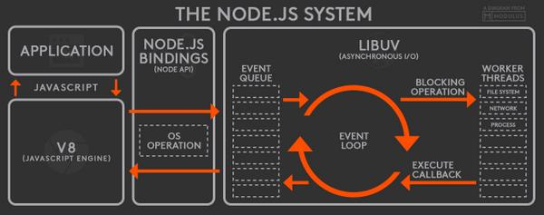

Slide 79
HTTP Module
The HTTP core module is a key module to Node.js networking.
To use the HTTP server in node, we need to require the HTTP module.
The HTTP module creates an HTTP server that listens to server ports and gives a response back to the client.
To make requests via the HTTP module http.request() method is used.

Slide 80
What is npm?
npm is the world's largest Software Registry.
The registry contains over 800,000 code packages.
Open-source developers use npm to share software.
Many organizations also use npm to manage private development.
You can download all npm public software packages without any registration or logon.
npm consists of three distinct components:
the website: Use the website to discover packages, set up profiles, and manage other aspects of your npm experience.
the Command Line Interface (CLI): The CLI runs from a terminal, and is how most developers interact with npm
the registry: The registry is a large public database of JavaScript software and the meta-information surrounding it.

Slide 81
npm cli
Local Installation
Production Packages
npm install --save <package_name>
npm install <package_name>
npm i <package_name>
Development Packages
npm install --save-dev <package_name>
npm install --dev <package_name>
npm i -D <package_name>
Local Un-installation
Production Packages
npm uninstall --save <package_name>
npm un <package_name>
Developement Packages
npm uninstall --save-dev <package_name>
npm un -D <package_name>

Slide 82
Express JS
Fast, unopinionated, minimalist web framework for Node.js
Express is a minimal and flexible Node.js web application framework that provides a robust set of features for web and mobile applications.
With a myriad of HTTP utility methods and middleware at your disposal, creating a robust API is quick and easy.

Slide 83
React JS
A JavaScript library for building user interfaces

Slide 84
Component vs Traditional Approach
HTML and CSS
HTML and CSS
0
+
-
0
+
-
domHandler
domHandler
Counter
{
count: 0,
next: function() { this.count +=1; } ,
prev: function() { this.count -=1; }
}
Counter
{
count: 0,
next: function() { this.count +=10; } ,
prev: function() { this.count -=10; }
}
<Counter />
<Counter interval=“10”/>

Slide 85
Desktop Application
(Cross Platform)
ELECTRON JS
BROWSER (Client Side)
REACTDOM
REACT COMPONENT
View* (UI) – JS / JSX
Style (CSS) – JSX / CSS
Data (Inside) – State
Data (Outside) –Props
Behaviour – Methods
Mobile Application
REACTNATIVE
Node JS App (Server Side)
REACTDOMSERVER

Slide 86
UI Composition (Composite UI Pattern)
NAVIGATION
ADVER.
MENU ITEM
MENU ITEM
MENU ITEM
MENU ITEM
SIDE NAVIGATION
LIST AREA
DETAILS AREA
STATUS

Slide 87
React Installation
Install Extensions on Google Chrome
React Developer Tools
https://chrome.google.com/webstore/detail/react-developer-tools/fmkadmapgofadopljbjfkapdkoienihi
Redux DevTools
https://chrome.google.com/webstore/detail/redux-devtools/lmhkpmbekcpmknklioeibfkpmmfibljd

Slide 88
Use React CLI
To Create a new Application
npx create-react-app first-react-app
cd first-react-app
Commands available in the application
npm start
Start the Development Server
npm run build
Bundles the app into static files for production.
npm test
Starts the test runner.
npm run eject
Removes this tool and copies build dependencies, configuration files and scripts into the app directory. If you do this, you can’t go back!

Slide 89
React Client Side Build
ES 2015 +
(Multiple Files)
react-scripts
Babel +
Preset (Env) +
Preset (React)
Polyfill (core-js)
Auto Configuration
react-cli (create-react-app)
Build & Deploy your
Project on Local Server
Build your project
Browser Compatible Files
(Multiple Files)
WEBPACK-DEV-
SERVER
WEBPACK
CLI
Bundling
BROWSER
WEBPACK
Single File / Set of Files
Local
HTTP Server
HTML PAGE
Deploy
Inject Bundles

Slide 90
Using Bootstrap
Install
npm i bootstrap
npm i bootstrap-icons
Include bootstrap and bootstrap-icons css file in index.js

Slide 91
Assignment
Create and render the following components
Component One
Hello from Component One (text-success)
Component Two
Hello from Component Two (text-primary)

Slide 92
State
The state is an updatable structure that is used to contain data or information about the component and can change over time.
The change in state can happen as a response to user action or system event.
It is the heart of the react component which determines the behavior of the component and how it will render.
It represents the component's local state or information.
It can only be accessed or modified inside the component or by the component directly.

Slide 93
Props
Props are read-only structure.
It is an object which stores the value of attributes of a component and work similar to the HTML attributes.
It allows passing data from one component to other components.
Props are immutable so we cannot modify the props from inside the component.

Slide 94
Props vs State
Props | State
Props are read-only. | State changes can be asynchronous.
Props are immutable. | State is mutable.
Props allow you to pass data from one component to other components as an argument. | State holds information about the components.
Props can be accessed by the child component. | State cannot be accessed by child components.
Props are used to communicate between components. | States can be used for rendering dynamic changes within the component.
Props make components reusable. | State cannot make components reusable.
Props are external and controlled by whatever renders the component. | The State is internal and controlled by the React Component itself.

Slide 95
Type checking With PropTypes
As your app grows, you can catch a lot of bugs with typechecking.
React has built-in typechecking abilities.
To run typechecking on the props for a component, you can assign the propTypes property.
You must use the prop-types library.
npm i prop-types
PropTypes exports a range of validators that can be used to make sure the data you receive is valid.

Slide 96
How Browser Renders a Web Page?
DOM
HTML Parser
DOM Tree
Layout
HTML
Attachment
Render Tree
Painting
Display
CSS
CSS Parser
Style Rules (CSSOM)

Slide 97
Solution – Virtual DOM
Virtual DOM is an in-memory representation of real DOM.
It is a lightweight JavaScript object which is a copy of Real DOM.
Whenever setState() method is called, ReactJS creates the whole Virtual DOM from scratch.
At any given time, ReactJS maintains two virtual DOM, one with the updated state Virtual DOM and other with the previous state Virtual DOM.
ReactJS using diff algorithm compares both the Virtual DOM to find the minimum number of steps to update the Real DOM.

Slide 98
Virtual DOM
Updating virtual DOM in ReactJS is faster because ReactJS uses
Efficient diff algorithm
Batched update operations
Efficient update of subtree only
Uses observable instead of dirty checking to detect the change

Slide 99
props
Call setState()
React Component
(state)
Render function of the
Component is called by
Event Fired
ReactDOM
Ready for User Interaction
DELTA’s will be rendered and Browser DOM will update
Virtual DOM
New Virtual DOM is compared with the Old Virtual DOM
DELTA’s

Slide 100
Methods & Properties in a React Component
Instance Methods
constructor()
render()
setState()
componentDidMount()
componentDidUpdate()
shouldComponentUpdate()
getSnapshotBeforeUpdate()
forceUpdate()
componentDidCatch()
componentWilUnmount()
Instance Propperties
state
props
context
Class Properties (static)
defaultProps
propTypes
displayName
contextType
Class Methods (static)
static getDerivedStateFromProps()
static getDerivedStateFromError()

Slide 101
Lifecycle Methods in a React Component
Mounting Phase
constructor()
static getDerivedStateFromProps()
render()
componentDidMount()
Updating Phase
static getDerivedStateFromProps()
shouldComponentUpdate()
render()
getSnapshotBeforeUpdate()
componentDidUpdate()
Unmounting Phase
componentWillUnmount()
Error Phase
static getDerivedStateFromError()
componentDidCatch()

Slide 102
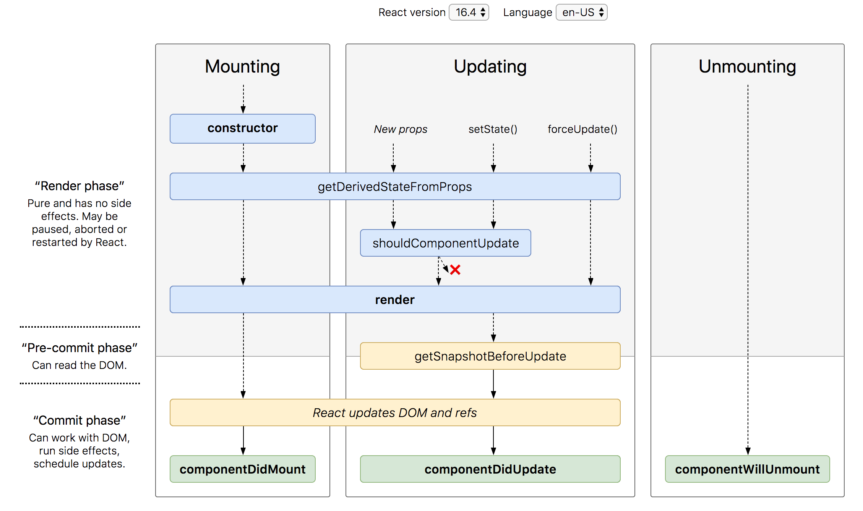
Lifecycle Methods

Slide 103
SyntheticEvent Object
Your event handlers will be passed instances of SyntheticEvent, a cross-browser wrapper around the browser’s native event.
It has the same interface as the browser’s native event, including stopPropagation() and preventDefault(), except the events work identically across all browsers.
The synthetic events are different from, and do not map directly to, the browser’s native events.

Slide 104
SyntheticEvent object attributes
boolean bubbles
boolean cancelable
DOMEventTarget currentTarget
boolean defaultPrevented
number eventPhase
boolean isTrusted
DOMEvent nativeEvent
void preventDefault()
boolean isDefaultPrevented()
void stopPropagation()
boolean isPropagationStopped()
void persist()
DOMEventTarget target
number timeStamp
string type

Slide 105
STATE
UI
X

Slide 106
Controlled Component
A controlled component is bound to a value, and its changes will be handled in code by using event-based callbacks.
The input form element is handled by the react itself rather than the DOM.
The mutable state is kept in the state property and will be updated only with setState() method.
Controlled components have functions that govern the data passing into them on every onChange event occurs.
The data is then saved to state and updated with setState() method. It makes component have better control over the form elements and data.

Slide 107
Uncontrolled Component
It is similar to the traditional HTML form inputs. Here, the form data is handled by the DOM itself.
It maintains their own state and will be updated when the input value changes.
To write an uncontrolled component, there is no need to write an event handler for every state update.
You can use a ref to access the value of the form from the DOM.

Slide 108
Controlled vs Uncontrolled
Controlled | Uncontrolled
It does not maintain its internal state. | It maintains its internal states.
Here, data is controlled by the parent component. | Here, data is controlled by the DOM itself.
It accepts its current value as a prop. | It uses a ref for their current values.
It allows validation control. | It does not allow validation control.
It has better control over the form elements and data. | It has limited control over the form elements and data.

Slide 109
Assignment 1 & 2
Complete the Calculator and Counter Assignment as per the problem statement shared in the code base.
Day 3 -> react-core-app -> src -> components -> 16_assignment

Slide 110
Assignment 3
Complete the CRUD assignment as per the screenshot shared in the next slide, use array to keep the data.
Create form-component and data-table-component as sibling components.
The data-table-component should be able to display array of any kind objects, do not fix the table to show only employees.

Slide 111
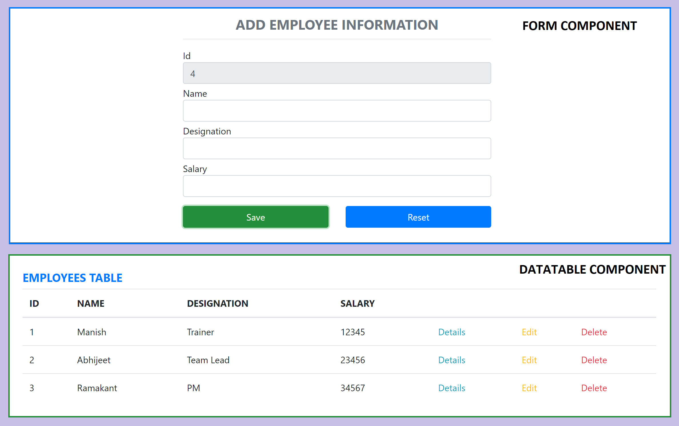
Assignment 3

Slide 112
Parent Child Communication
PARENT
PARENT
Props
ref
Parent
Method
Reference
CHILD
CHILD

Slide 113
Sibling Communication
Parent Component
Parent
Method
Reference
props
CHILD Component
1
CHILD Component
2

Slide 114
Context
In a typical React application, data is passed top-down (parent to child) via props, but such usage can be cumbersome for certain types of props that are required by many components within an application.
Context provides a way to share values between components without having to explicitly pass a prop through every level of the tree.

Slide 115
Sibling Communication
CONTEXT
Parent Component
CHILD Component
1
CHILD Component
2

Slide 116
Error Boundaries
If the errors are not handled, the react component will crash and show a blank UI.
Error boundaries are React components that catch JavaScript errors anywhere in their child component tree, log those errors, and display a fallback UI instead of the component tree that crashed.
Error boundaries catch errors during rendering, in lifecycle methods, and in constructors of the whole tree below them.
Error boundaries do not catch errors for:
Event handlers
Asynchronous code (e.g. setTimeout or requestAnimationFrame callbacks)
Server side rendering
Errors thrown in the error boundary itself (rather than its children)

Slide 117
Create an Error Boundary
A class component becomes an error boundary if it defines either (or both) of the lifecycle methods static getDerivedStateFromError() or componentDidCatch()
Use static getDerivedStateFromError() to render a fallback UI after an error has been thrown.
Use componentDidCatch() to log error information.
The granularity of error boundaries is up to you.
You may wrap top-level components to display a “Something went wrong” message to the user, just like how server-side frameworks often handle crashes.
You may also wrap individual components in an error boundary to protect them from crashing the rest of the application.

Slide 118
Portals
Portals provide a first-class way to render children into a DOM node that exists outside the DOM hierarchy of the parent component.
A typical use case for portals is when a parent component has an overflow: hidden or z-index style, but you need the child to visually “break out” of its container.
For example, dialogs, hovercards, and tooltips.

Slide 119
AJAX and APIs
You can use any AJAX library you like with React.
Some popular libraries are:
Axios
jQuery AJAX
window.fetch
XMLHttpRequest
You should populate data with AJAX calls in the commit phase lifecycle methods like componentDidMount().
Use setState to update your component when the data is retrieved.

Slide 120
React Router
React Router is the de-facto React routing library, and it’s one of the most popular projects built on top of React.
React at its core is a very simple library, and it does not dictate anything about routing.
Routing in a Single Page Application is the way to introduce some features to navigating the app through links, which are expected in normal web applications:
The browser should change the URL when you navigate to a different screen
Deep linking should work: if you point the browser to a URL, the application should reconstruct the same view that was presented when the URL was generated.
The browser back (and forward) button should work like expected.
Routing links together your application navigation with the navigation features offered by the browser: the address bar and the navigation buttons.
React Router offers a way to write your code so that it will show certain components of your app only if the route matches what you define.

Slide 121
Router Components
Install
npm i react-router-dom@5
The 3 components you will interact the most when working with React Router are:
BrowserRouter wraps all your Route components.
Link/NavLink components are used to generate links to your routes
Route components are responsible for showing - or hiding - the components they contain.

Slide 122
NODE SERVER
BROWSER
HTTP + URL (localhost:3000)
NAVIGATION
React Application
Click on Admin Link, call to the API is done on componentDidMount and display the data in Datatable
HTML Page + JS (React App)
NODE SERVER
EXPRESS JS
Web API
AJAX – localhost:8000/api/products
Database
JSON

Slide 123
NODE SERVER
BROWSER
HTTP + URL (localhost:3000)
NAVIGATION
React Application
Click on Admin Link, code to verify token in browser’s sessionStorage, if not, we will be redirected to LoginComponent
HTML Page + JS (React App)
HTTP + URL (AJAX) + Username & Password
NODE SERVER
EXPRESS JS
Web API
JSON with Token
{“token”:”___”}
Store Token in Session
Storage of the browser
Send the same token to
Access data from the
server
AJAX – localhost:8000/api/products + Token
Database
JSON

Slide 124
Secure Application using Custom Route
When user clicks the Admin Link, we need to verify that we have a token in session storage, and if the token in not there in the session storage, redirect the request to login component. (SecuredRoute)
SecuredRoute uses AuthenticatorClient’s isAuthenticated to verify.
If false, the request is redirected to Login Component
If true, the request is allowed for Admin Component.
Logging and Token Management (AuthenticatorClient)
On Login Component, user must give username and password, which will be sent to Node API Server
If the username & password is correct, in the response; token will come from the Server
Received token will be stored in the session storage of the browser and isAuthenticated will be set to true.
Reading and Attaching Token
Whenever the AJAX request is made for api, we must read and attach the token in the request header.
We use AuthenticatorClient getToken() to read the token from session storage.

Slide 125
Secure Application using Custom Route
When user clicks the Admin Link, we need to verify that we have a token in session storage, and if the token in not there in the session storage, redirect the request to login component. (SecuredRoute)
SecuredRoute uses AuthenticatorClient’s isAuthenticated to verify.
If false, the request is redirected to Login Component
If true, the request is allowed for Admin Component.
Logging and Token Management (AuthenticatorClient)
On Login Component, user must give username and password, which will be sent to Node API Server
If the username & password is correct, in the response; token will come from the Server
Received token will be stored in the session storage of the browser and isAuthenticated will be set to true.
Reading and Attaching Token (fetch-interceptor)
Whenever the AJAX request is made for api, we must read and attach the token in the request header.
We use AuthenticatorClient getToken() to read the token from session storage.

Slide 126
React Component Libraries
https://react-bootstrap.github.io/
https://www.telerik.com/kendo-react-ui/
https://mui.com/
https://www.primefaces.org/primereact/showcase/#/datatable/striped
https://www.ag-grid.com/react-data-grid/?gclid=CjwKCAjwkvWKBhB4EiwA-GHjFjNh-cU_V1gzxcx1nte3R8wTjRGM_WdbOfVoOu0Kf4PWyQumjeHFCBoCLNoQAvD_BwE

Slide 127
HOC (Higher Order Components)
HOC is a pattern that emerges from React’s compositional nature.
A higher-order component (HOC) is an advanced technique in React for reusing component logic.
Component transforms props into UI, a higher-order component transforms a component into another component.
A higher-order component is a function that takes a component and returns a new component.

Slide 128
Why HOC?
Reason to use Higher-Order component:
Easy to handle
Get rid of copying the same logic in every component
Makes code more readable

Slide 129
Redux
Redux is a pattern and library for managing and updating application state, using events called "actions".
It serves as a centralized store for state that needs to be used across your entire application, with rules ensuring that the state can only be updated in a predictable fashion.
The patterns and tools provided by Redux make it easier to understand when, where, why, and how the state in your application is being updated, and how your application logic will behave when those changes occur.

Slide 130
When Should I Use Redux?
Redux helps you deal with shared state management, but like any tool, it has tradeoffs. There are more concepts to learn, and more code to write. It also adds some indirection to your code and asks you to follow certain restrictions. It's a trade-off between short term and long-term productivity.
Redux is more useful when:
You have large amounts of application state that are needed in many places in the app
The app state is updated frequently over time
The logic to update that state may be complex
The app has a medium or large-sized codebase, and might be worked on by many people
Not all apps need Redux. Take some time to think about the kind of app you're building and decide what tools would be best to help solve the problems you're working on.

Slide 131
Redux Terminology
Actions - An action is a plain JavaScript object that has a type field. You can think of an action as an event that describes something that happened in the application.
Action Creators - An action creator is a function that creates and returns an action object. We typically use these, so we don't have to write the action object by hand every time
Reducers - A reducer is a function that receives the current state and an action object, decides how to update the state if necessary, and returns the new state. You can think of a reducer as an event listener which handles events based on the received action (event) type.
Store - The current Redux application state lives in an object called the store . The store is created by passing in a reducer.
Dispatch - The Redux store has a method called dispatch. The only way to update the state is to call store.dispatch() and pass in an action object. The store will run its reducer function and save the new state value inside. You can think of dispatching actions as "triggering an event" in the application.
Selectors - Selectors are functions that know how to extract specific pieces of information from a store state value.

Slide 132

Redux Application Data Flow

Slide 133
1
Will use the action types to identify an action which is dispatched, to do a specific operation on Store State
ACTION TYPE
Constants (string / symbol)
Will use action types to create an action object
3
R1
R2
R3
2
ACTION CREATOR
A function which creates and returns an Action object
ROOT REDUCER
REDUX STORE
Application State
4
ACTION OBJECT
Plain JavaScript Object
{
type: ActionType,
payload: data
}
CONTAINER COMPONENT
5
Dispatch
Action
Data Flow
PRESENTATIONAL COMPONENT (s)
6
mapDispatchToProps
mapStateToProps
Connection to Action Creator(s)
Connection to Reducer(s)

Slide 134
Redux Middleware and Side Effects
Redux store doesn't know anything about async logic. It only knows how to synchronously dispatch actions, update the state by calling the root reducer function, and notify the UI that something has changed.
Any asynchronicity has to happen outside the store.
Redux reducers must never contain "side effects". A "side effect" is any change to state or behavior that can be seen outside of returning a value from a function.
Some common kinds of side effects are things like:
Logging a value to the console
Saving a file
Setting an async timer
Making an AJAX HTTP request
Modifying some state that exists outside of a function, or mutating arguments to a function
Generating random numbers or unique random IDs (such as Math.random() or Date.now())
Redux middleware were designed to enable writing logic that has side effects.

Slide 135
Thunk Middleware – Async Data Flow
Thunk is a logical concept in programming where you deal with a function that is primarily used to delay the calculation or evaluation of any operation.
Redux Thunk acts as a middleware that will return you a function instead of an object while calling through the action creators.
The returned function receives the dispatch method from the store and then later it is used to dispatch synchronously inside the body of function once the asynchronous actions have been completed.

Slide 136
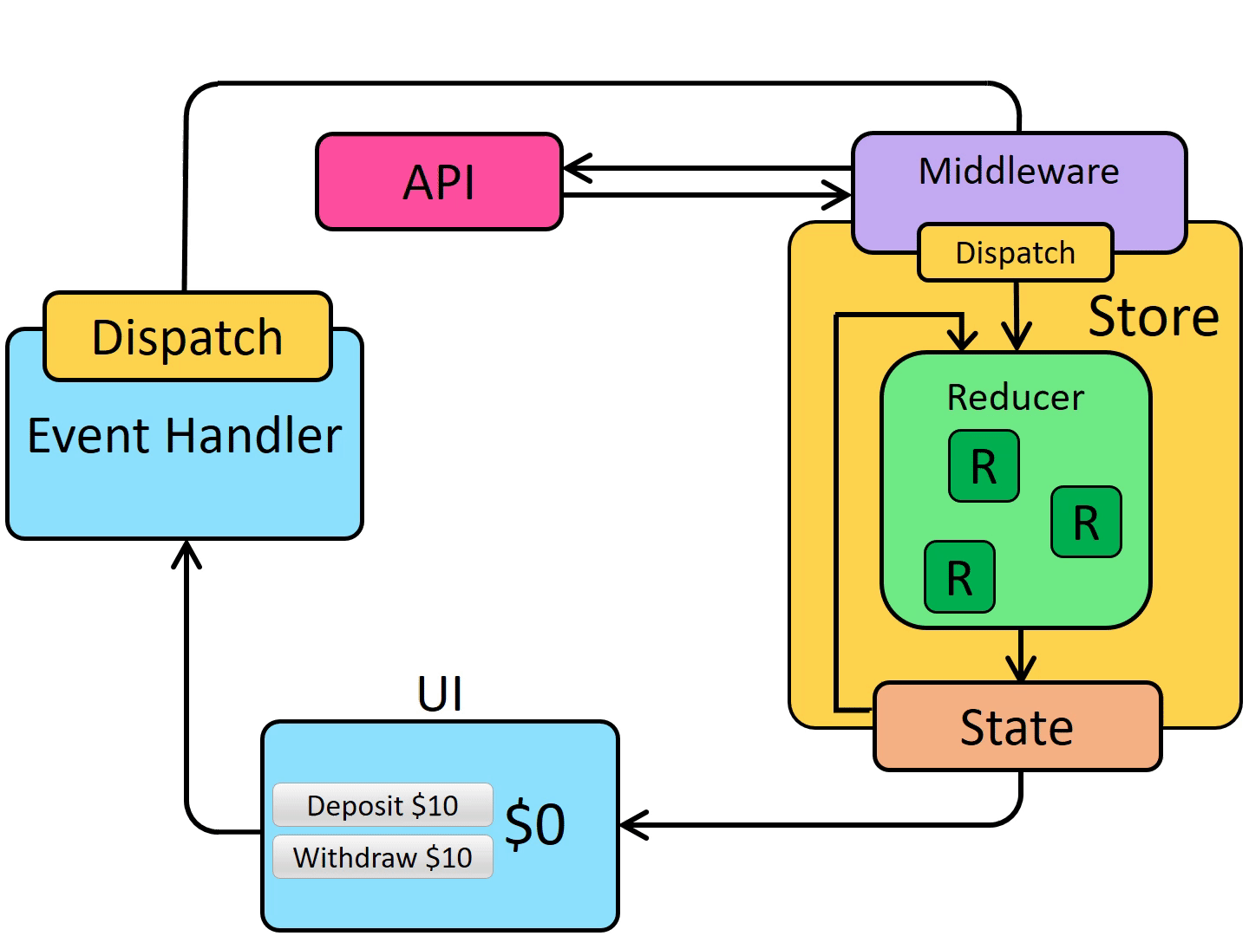
Redux Application Async Data Flow

Slide 137
1
Will use the action types to identify an action which is dispatched, to do a specific operation on Store State
ACTION TYPE
Constants (string / symbol)
Will use action types to create an action object
Dispatch
Action
3
R1
R2
R3
2
ACTION CREATOR
A function which creates and returns an Action object
REDUX
THUNK
MIDDLEWARE
API SERVER
ROOT REDUCER
A function that takes parameter dispatch
REDUX STORE
Application State
4
ACTION OBJECT
Plain JavaScript Object
{
type: ActionType,
payload: data
}
CONTAINER COMPONENT
5
Dispatch
To Function
Data Flow
PRESENTATIONAL COMPONENT (s)
6
mapDispatchToProps
mapStateToProps
Connection to Action Creator(s)
Connection to Reducer(s)

Slide 138
Points to Remember
ActionTypes are used for Creating Action Objects and also helps reducer to recognize Action which is dispatched to it.
REACT COMPONENT -> DISPATCHER -> ACTION -> REDUCER -> STORE -> REACT COMPONENT
How Component will know about the Dispatch/Dispatcher?
Component uses connect() to get access to the Dispatch which is used in mapDispatchToProps()
In functional components we use useDispatch() Hook
How Component will know about the State?
Component uses connect() to get access to state which is used in mapStateToProps(),
In functional components we use useSelector() Hook
How Component will know about the Actions?
Component takes the actions (action Objects) to be performed from ActionCreators (counterActions, productActions)

Slide 139
React best practices
Keep components small and function-specific
Reusability is important, so keep creation of new components to the minimum required
Consolidate duplicate code – DRY your code
Put CSS in JavaScript
Name the component after the function
Separate stateful aspects from rendering
Prefer Immutation over Mutation of Data
Prefer to write Pure Function

Slide 140
Assignment / Practice
Complete the Requested and Failed logic for
Insert
Update
Delete
In the Redux application, consume the node-api-server (Day4) and create a CRUD application using fetch-interceptor
Complete the CRUD application using only Functional Components with Hooks.
Change Router from v5 to v6, in Redux application

Slide 141
Further Learning
Do it only after you have completed the code and assignments and comfortable with what we covered in the training

Slide 142
Redux Saga Middleware
Saga pattern is way a to handle long running transactions with side effects or potential failures.
Redux-saga is a redux middleware library, that is designed to make handling side effects in your redux app nice and simple.
It achieves this by leveraging an ES6 feature called Generators, allowing us to write asynchronous code that looks synchronous.

Slide 143
Thunk vs Saga
Thunk | Saga
Created by Redux Creator | Created by third party developers
Runs in any JavaScript Context | Only runs in ES6 environments that support yield
Has no built-in solution for asynchronous calls | Uses yield and generator functions to simplify async
No way to orchestrate side-effects between thunks | Uses effects and plain actions to coordinate sagas

Slide 144
React Hook Form
React Hook Form reduces the amount of code you need to write while removing unnecessary re-renders.
Features
Built with performance, UX and DX in mind
Embraces native HTML form validation
Out of the box integration with UI libraries
Small size and no dependencies
Support Yup, Zod, AJV, Superstruct, Joi, Vest, class-validator, io-ts, nope and custom build

Slide 145
Contact Me
Manish Sharma | Gmail
Manish Sharma | WhatsApp
Manish Sharma | Facebook
Manish Sharma | LinkedIn

